Slide 1
Automation Helper for Literature Reviews
Kaan Apaydin, Stefan David Horak, Yorck Zisgen

Slide 2

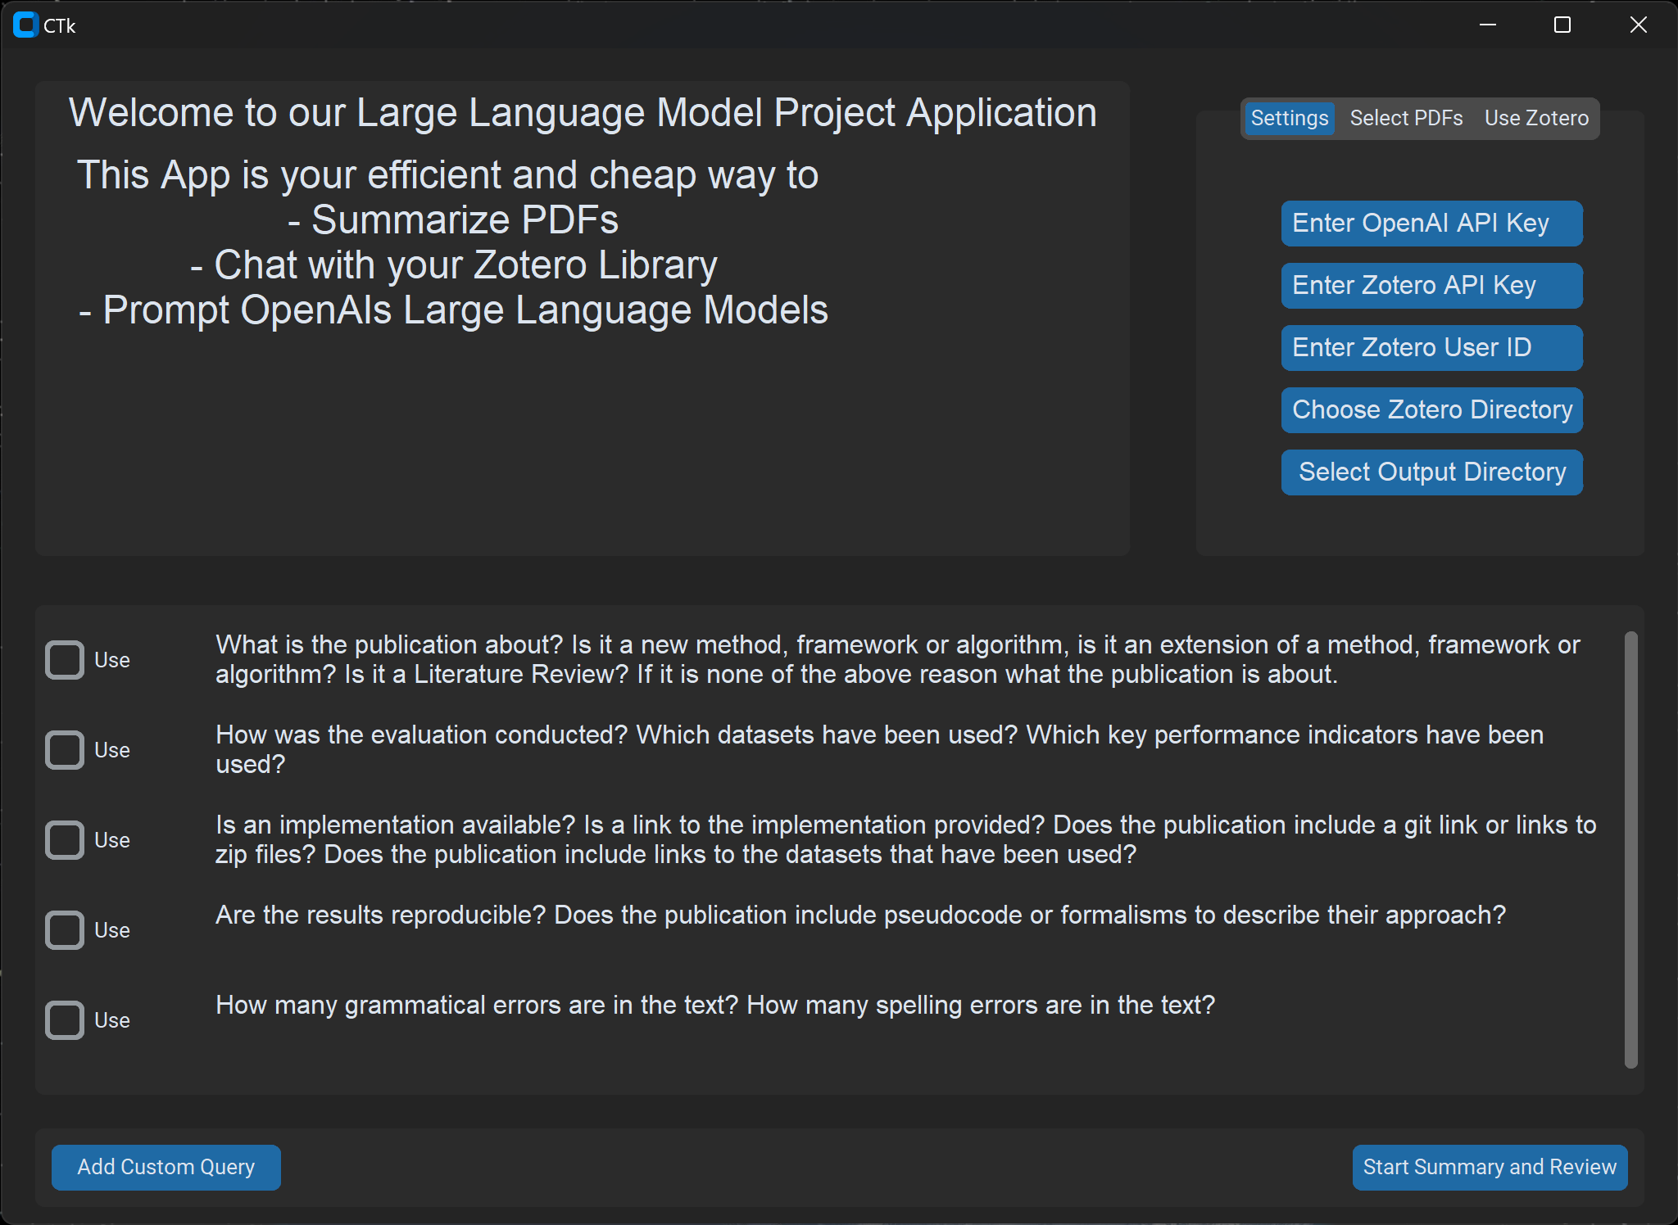


Automation Helper for Literature Reviews
Kaan Apaydin
M. Sc. Business Information Systems, CAU
Ph.D. Student at the University of Kiel at the Chair of B.I.S. and Process Analytics
Stefan David Horak
B.A. Multimedia Production, FH Kiel
10 years in video production
Founder MALA Yoga, SmarterDoc
Hier kommt ein Screenshot rein
Yorck Zisgen
M. Sc. Business Information Systems, CAU
Ph.D. Student at the University of Bayreuth
at the Chair of B.I.S. and Process Analytics

Slide 3





Automation Helper for Literature Reviews
The Automation Helper takes a set of PDF files as input ...
… and generates a single output file (.docx format).

Slide 4
Automation Helper for Literature Reviews
The output file contains:
Title, authors, publication date,
a set of related keywords,
word count and estimated read length,
short and long summaries,
answers to all queries given (incl. references),
all images contained in the original PDF file
… of every PDF file passed into it.
Useful for researchers in all domains.

Slide 5
Automation Helper for Literature Reviews
Live Demonstration

Slide 6
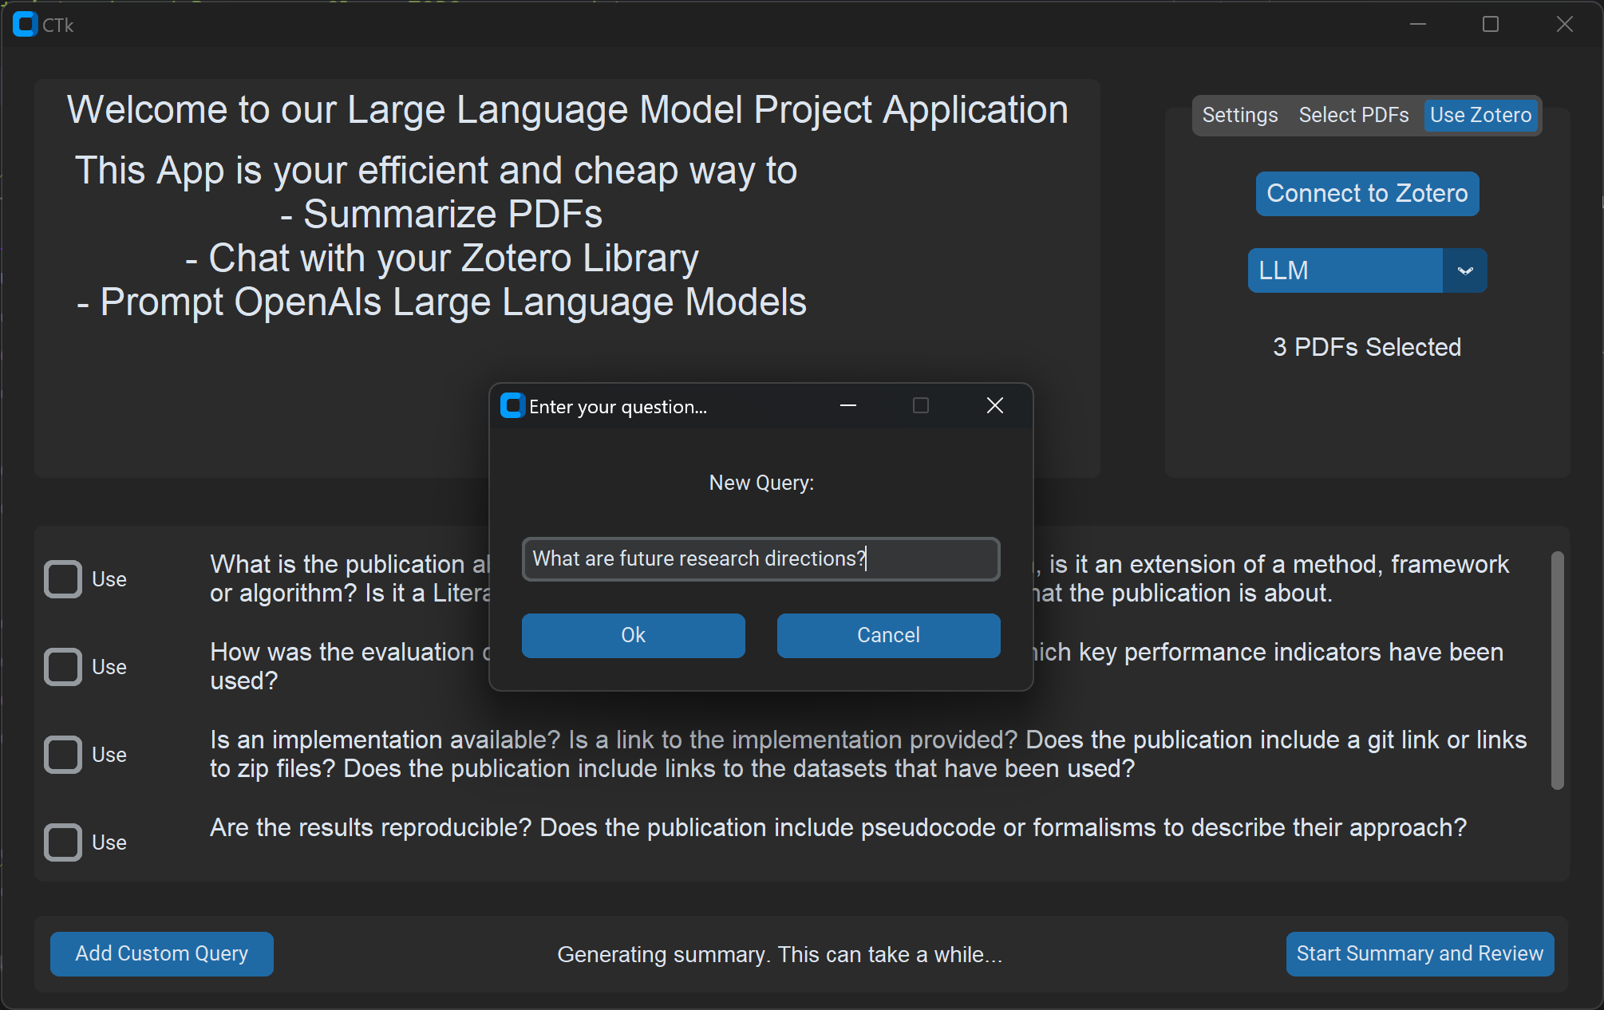
Automation Helper for Literature Reviews
GUI
Started with Tkinter
python based GUI for small prototypes
Transfered to CustomTkinter
more modern and consistent design
still lightweight with similiar ease of implementation
Outlook: Transfer to Flet
Python-based cross-plattform supporting App Development Framework powered by Flutter
Truly modern and responsive design
Bitte ergänzen
Notes:
Nach dieser Folie erfolgt eine kurze Live-Demonstration der Software.

Slide 7
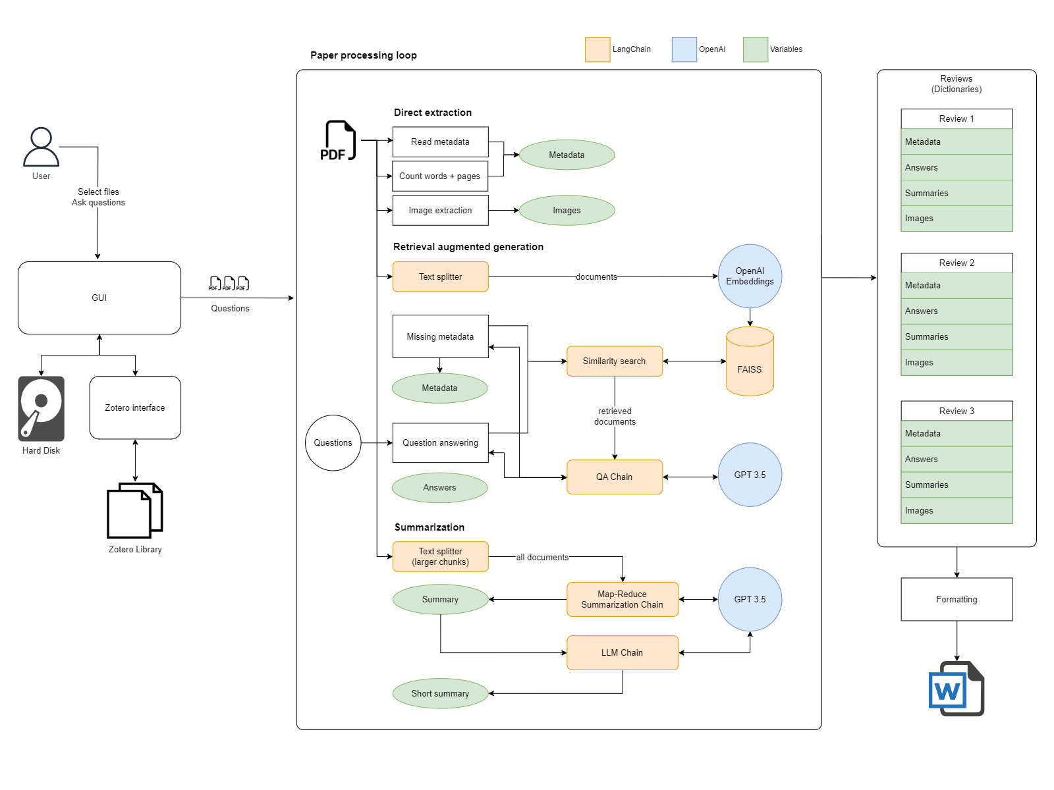
Data Handling
pypdf2
fitz
Pillow
docx
Embeddings
OpenAI
LLM
OpenAI GPT 3.5 Turbo
LangChain
Database
FAISS
Challenges and Solutions
Q&A vs. summarization
Metadata
Images
Bitte ergänzen

Slide 8
Automation Helper for Literature Reviews
Future Enhancements I (until release)
Successfully extracting header data (authors, title)
Improving image extraction
Improving GUI
Cleaning up code, adding a license, and publishing the project as open source
Notes:
Header data: currently difficulties finding anything at all. Possible solution: take text body, write a prompt that asks to examine the first 50 words
Image extraction: images taken out of context do not provide insights; finding correct physical dimensions of an unknown quantity of images. Solution: make two or three fixed settings based on images count
Improving GUI: Layout and resizing of elements
Adding a license: CC-BY-NC-SA 4.0 (reference original authors, keep, distribute, edit, non-commercial use, redistribution under 'alike conditions'

Slide 9
Automation Helper for Literature Reviews
Future Enhancements II (after release)
Connecting to Zotero group libraries and potentially Citavi as well
Moving queries from the GUI into a loadable file (e.g. XML)
Working on run-time-per-paper
Adding singular analysis documents to each Zotero entry

Slide 10
Automation Helper for Literature Reviews
Closing Remarks
Decreases cognitive load of assessing the relevance of an unknown paper
Decreases evaluation time of papers
Adds automated insight such as word count, estimated read time, categorization of the paper, or applied evaluation methods
Supports and speeds up elementary scientific work

Slide 11
Automation Helper for Literature Reviews - Discussion -

Slide 12
Automation Helper for Literature Reviews
The Automation Helper takes a set of PDF files as input ...
Either from an 'Open File Dialogue'
or directly from a connected Zotero library
It generates a single output file (.docx format) that contains:
Title, authors, publication date,
a set of related keywords,
word count and estimated read length,
short and long summaries,
all images contained in the original PDF file
… of every PDF file passed into it.
Useful for Researchers in all domains.

Slide 13
Automation Helper for Literature Reviews
Hier kommen mehrere (3-4) Screenshots rein.
z.B. GUI, Open File Dialogue, Zotero, Output File
Notes:
Nach dieser Folie erfolgt eine kurze Live-Demonstration der Software.

Slide 14
Automation Helper for Literature Reviews
● GUI Framework: Kaan? CustomTkinter?
● Data Handling: David?
● Embedding Models: David?
● Large Language Model (LLM): David?
● Database Utilization: -
● LangChain: David?
● Challenges and Solutions: Share significant challenges encountered and how they were resolved.
Notes:
Nach dieser Folie erfolgt eine kurze Live-Demonstration der Software.

